Slide 1
Live Session 12
By Ben Goodwin

Slide 2
Activity 2
Personal Github website:
https://bgoodwinSMU.github.io

Slide 3
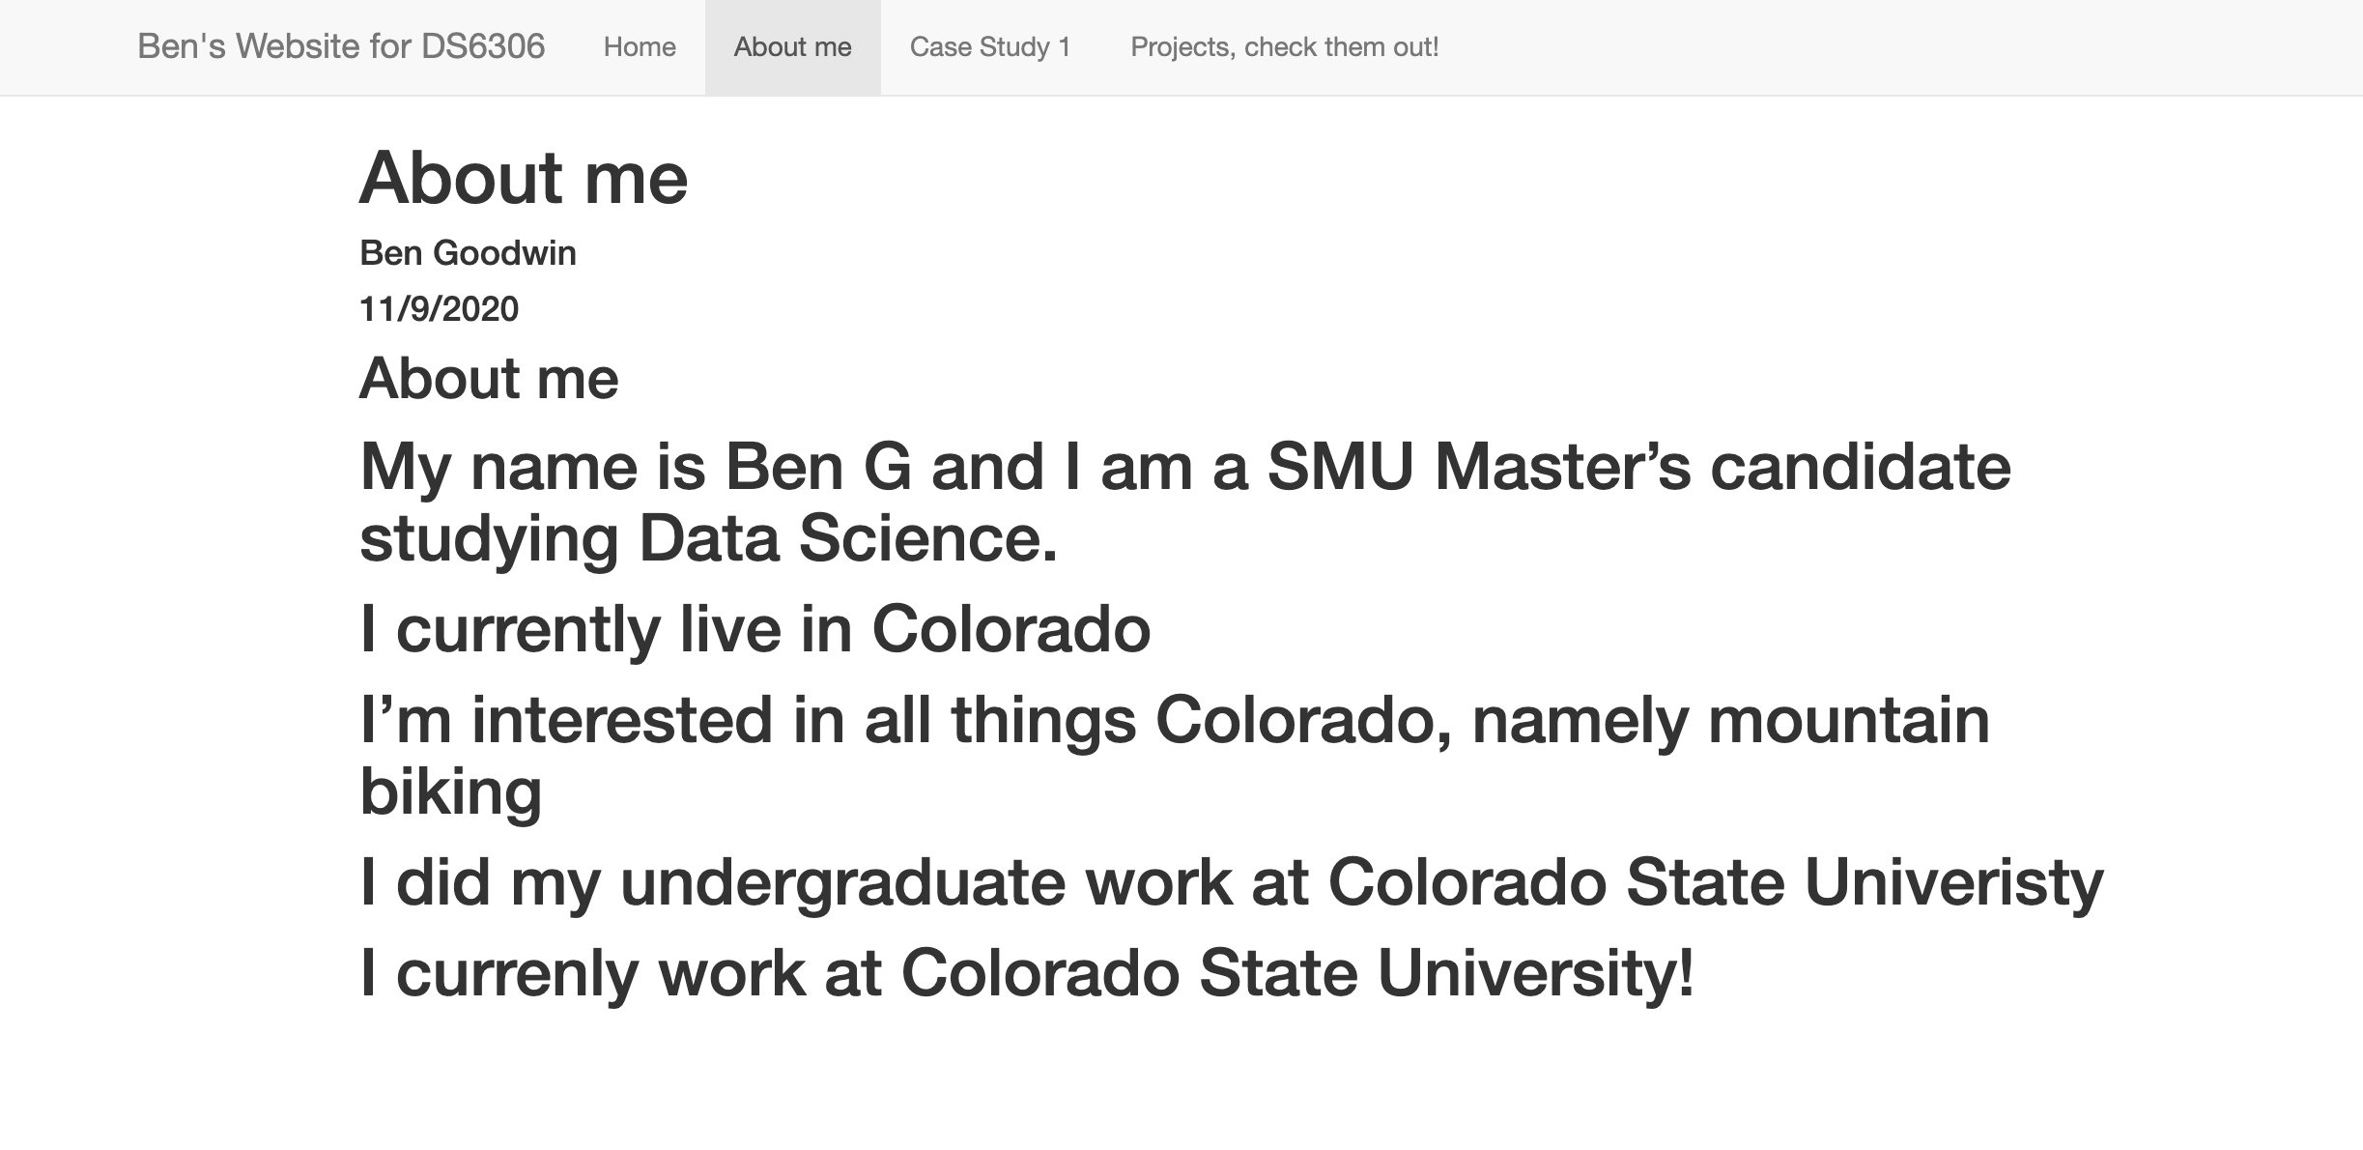
Activity 3, Welcome Tab
https://bgoodwinsmu.github.io/aboutme.html

Slide 4
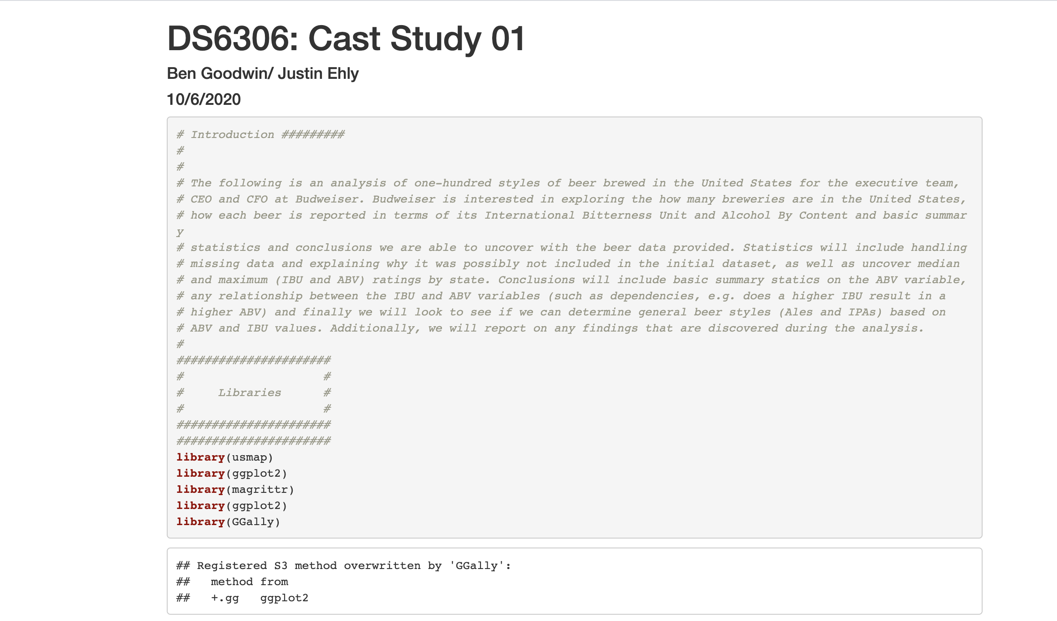
Activity 4, Case Study 1 Tab
https://bgoodwinsmu.github.io/casestudy1.html

Slide 5
Activity 5, Create an R Shiny App

